Slide 1
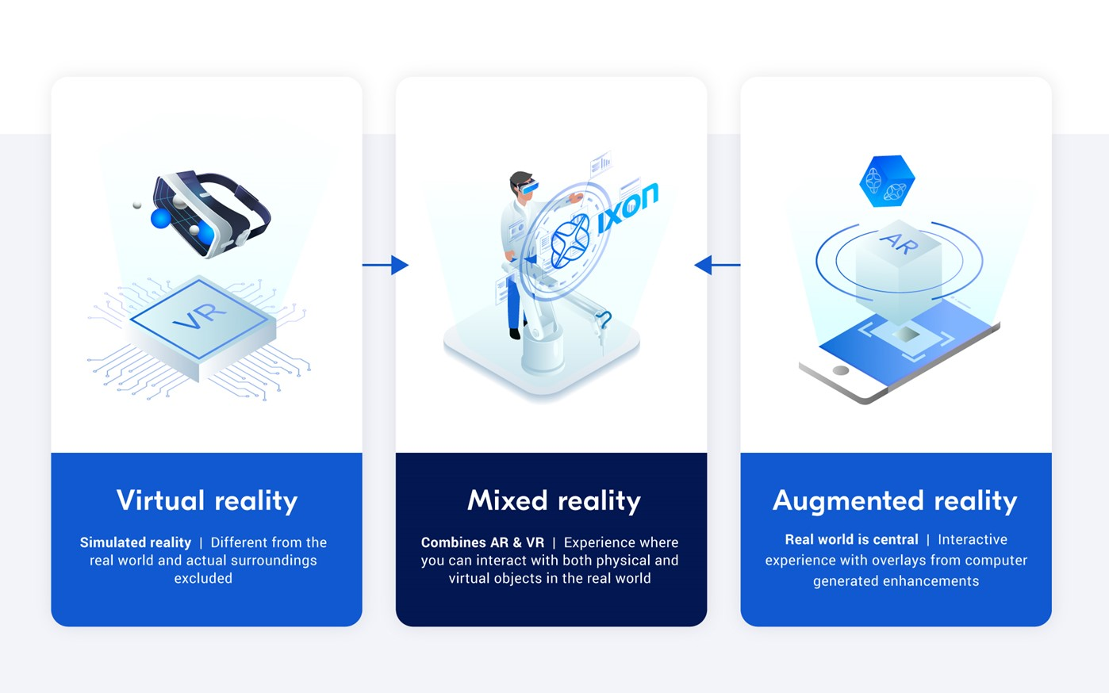
Ixon Cloud. (2018) Augmented reality in machine manufacturing. [Image] https://www.ixon.cloud/augmented-reality

Slide 2
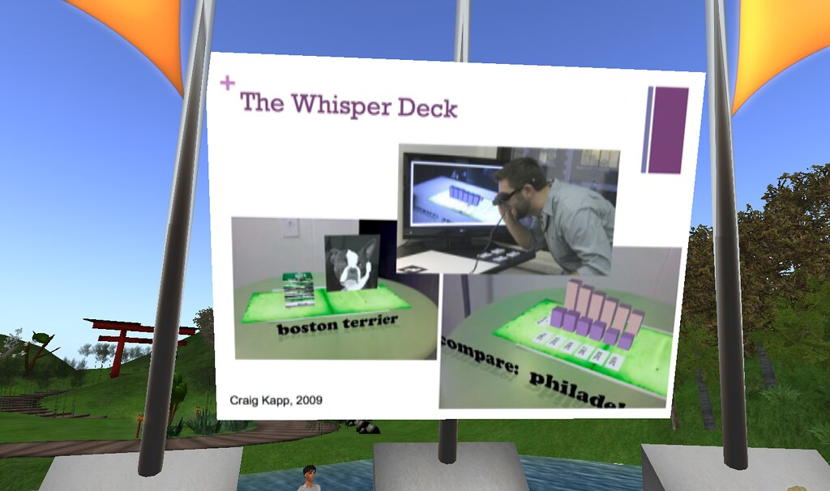
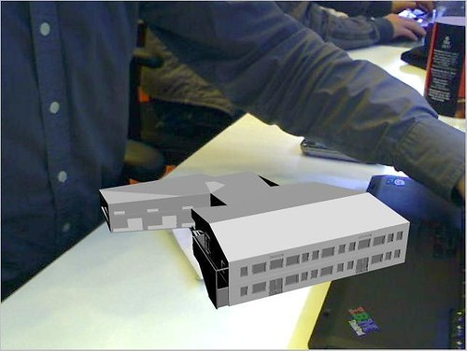
"Augmented Reality in the Classroom Craig Knapp_007" by caswell_tom
"Home Made Augmented Reality" by T. Geersing

Slide 3
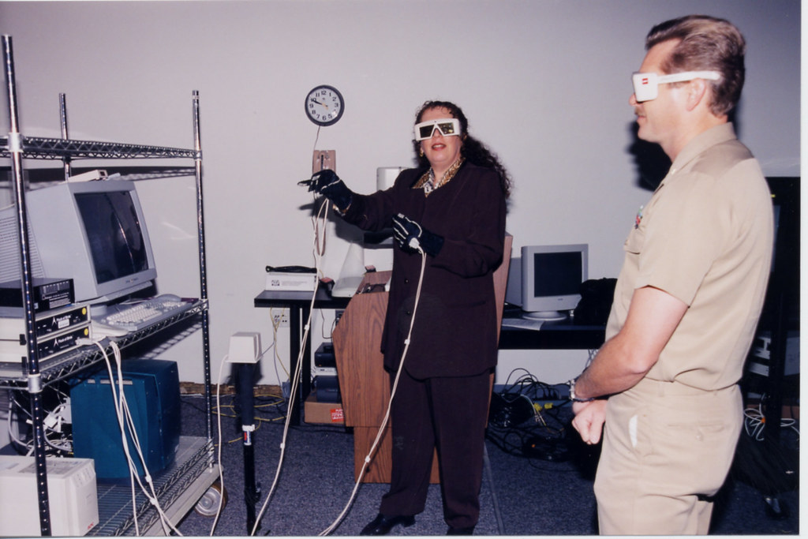
Virtual Reality Demo" by Uniformed Services University

Slide 4
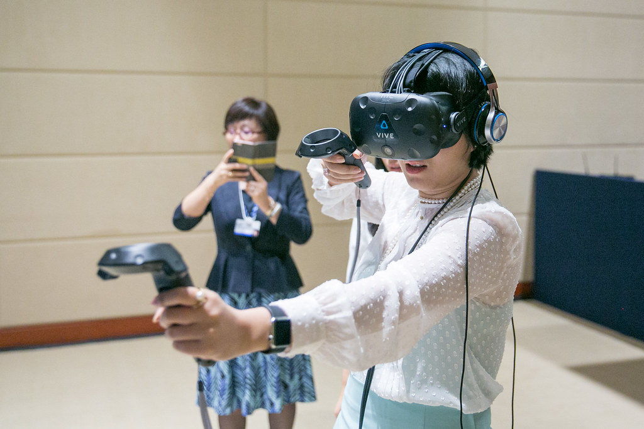
"Spotlight on Virtual Reality: Robot Repair" by World Economic Forum

Slide 5
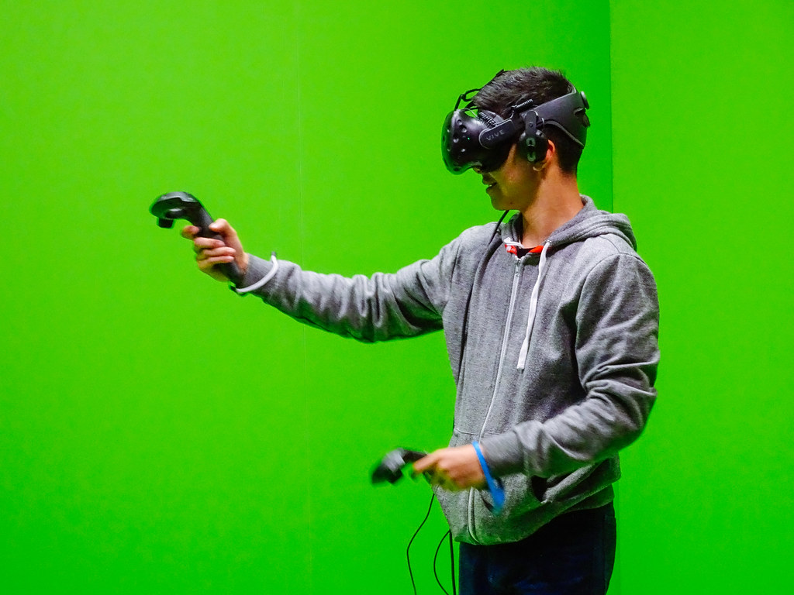
"VR" by gordonplant

Slide 6
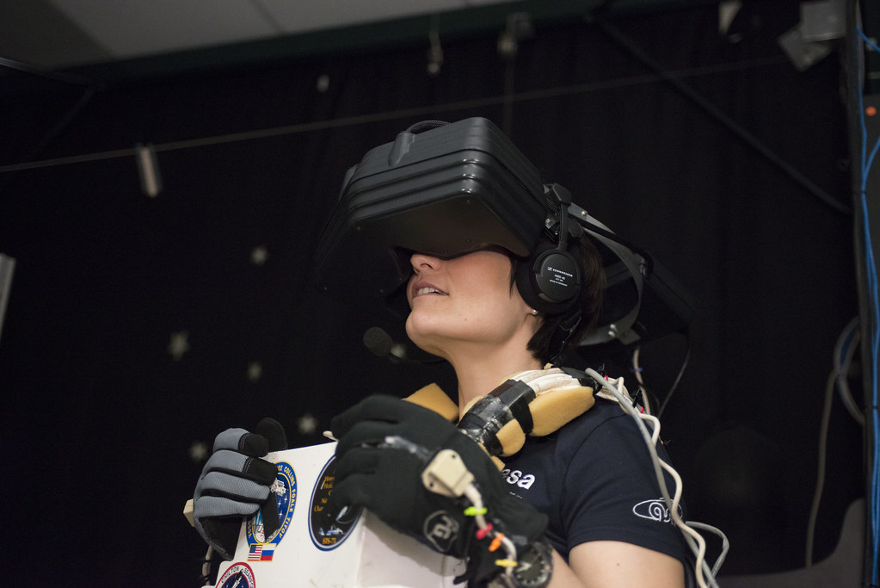
"EVA training in the virtual reality lab" by AstroSamantha

Slide 7
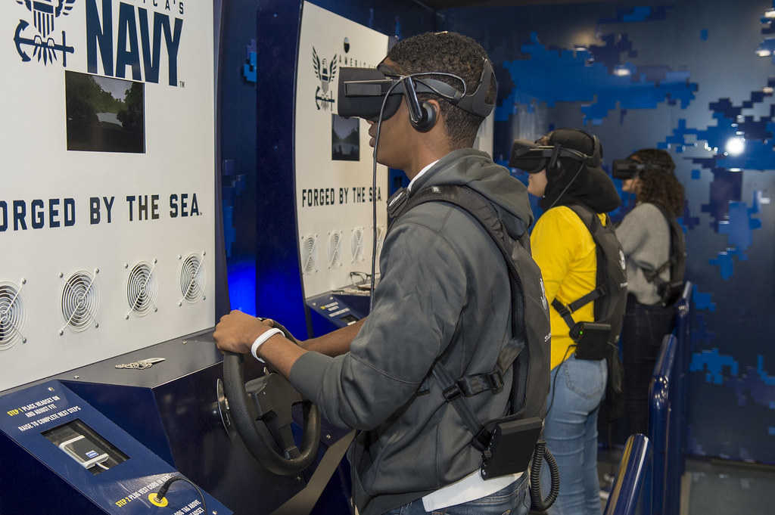
"Students of Celebration High School participate in the Navy’s virtual reality asset." by Official U.S. Navy Imagery

Slide 8
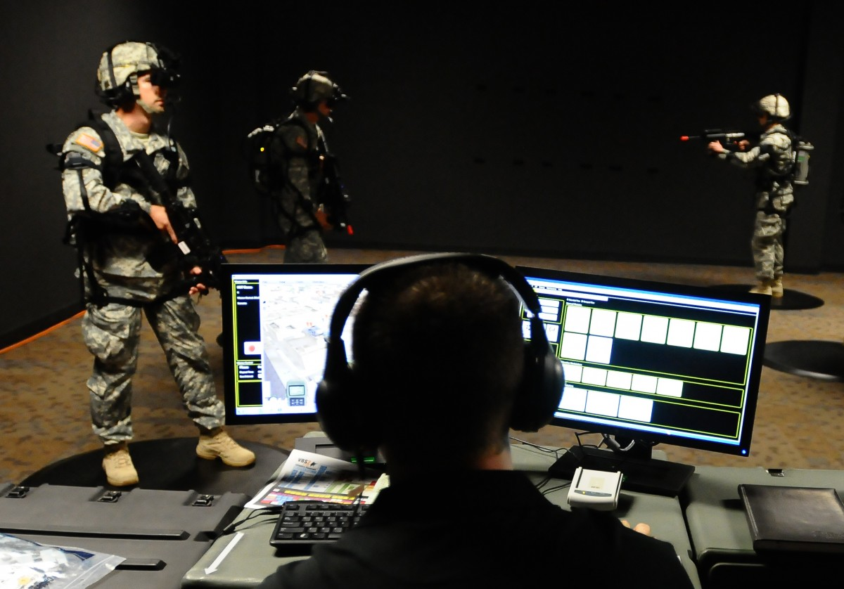
U.S. Army. (2012) Virtual reality used to train Soldiers in new training simulator. [Image] https://www.army.mil/VR_to_train_soldiers

Slide 9
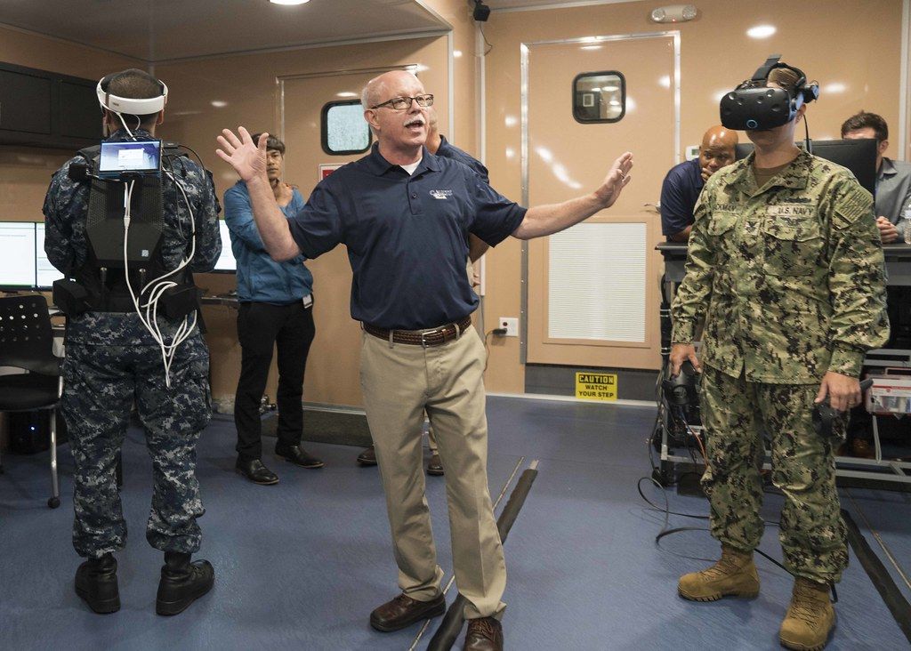
"Sailors present the Carrier-Advanced Reconfigurable Training Systems simulator." by Official U.S. Navy Imagery

Slide 10
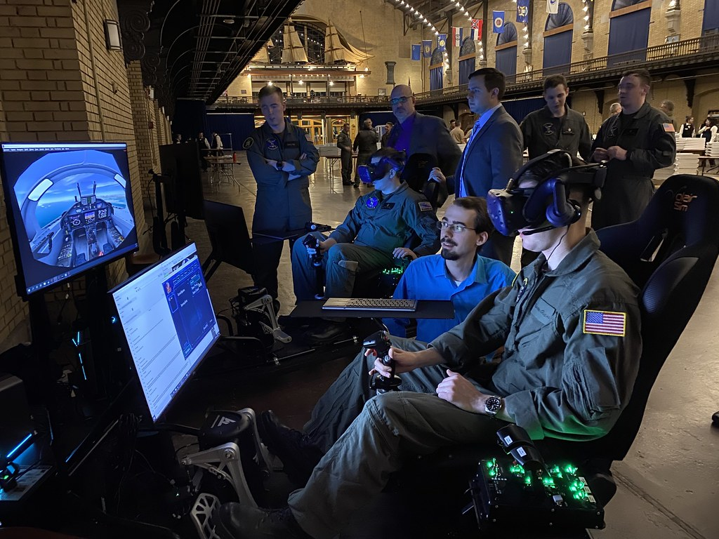
"A midshipman conducts a simulated T-6B Texan II flight on a newly installed virtual reality trainer at the U.S. Naval Academy." by Official U.S. Navy Imagery

Slide 11
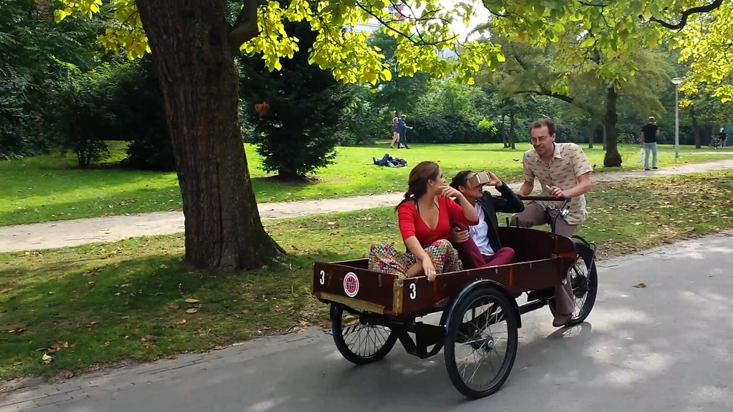
"Virtual Reality tourism" by sndrv

Slide 12

"Sandia Stone Cabin VR Panorama" by snowpeak

Slide 13

"Cross-Eyed Stereo 3D Test - April 2010" by rbatina

Slide 14

"the VR room...almost like paris" by .inKenzo. evonne@amoration

Slide 15
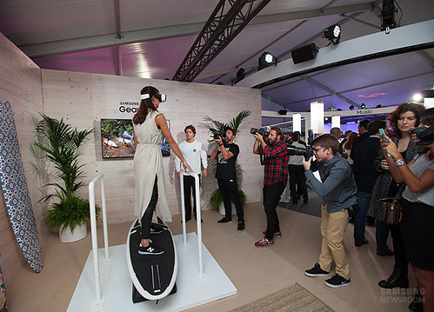
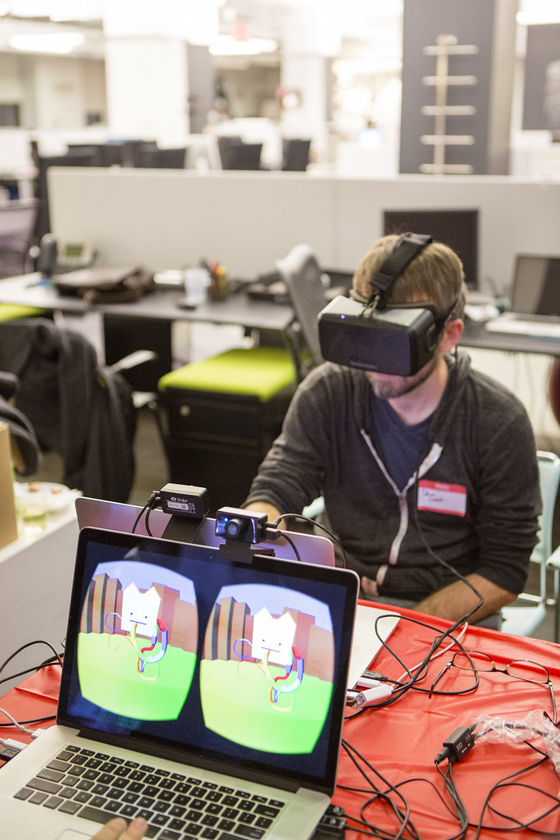
"Samsung Gear S2 and Gear VR Harness the Charm of the Circle" by Samsung Newsroom
"Future Interfaces 2014" by NYC Media Lab

Slide 16
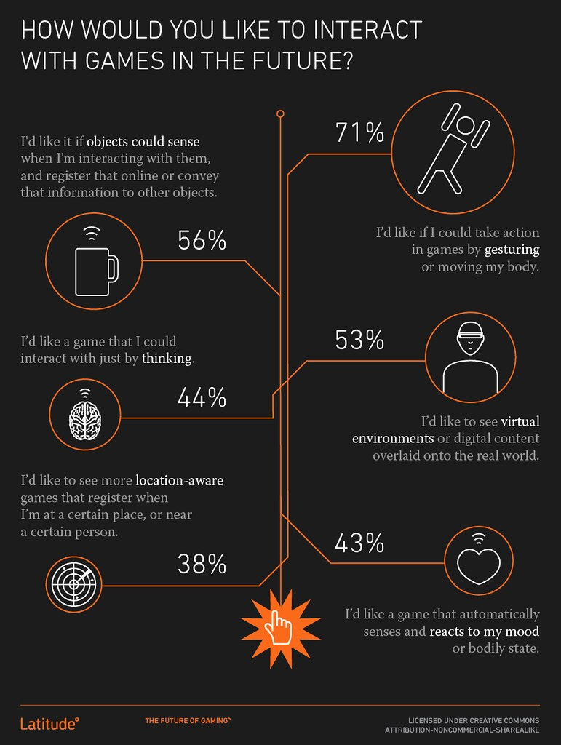
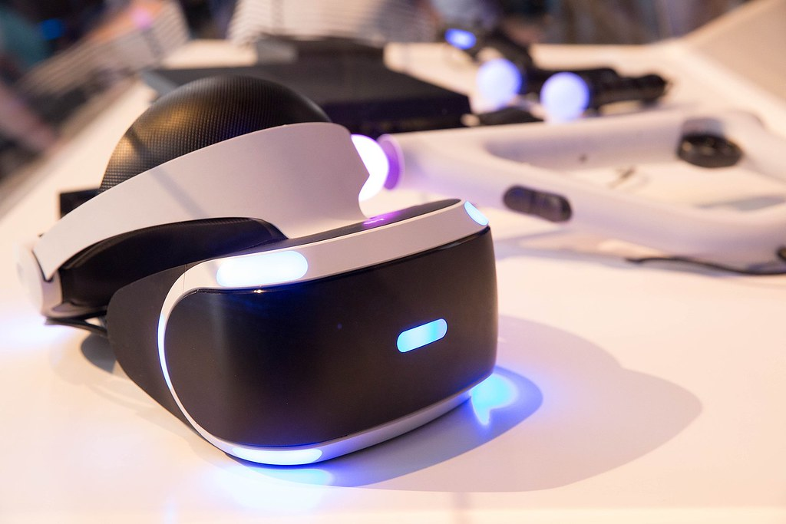
"Science and Technology" by US Department of State

Slide 17

"Space Shuttle Endeavour 360° VR Panorama" by jurvetson

Slide 18

Royal Flying Doctor Service. (n.d.) Royal Flying Doctor Service and the Bombing of Darwin. [Image] https://www.rfdsdarwin.com.au/

Slide 19
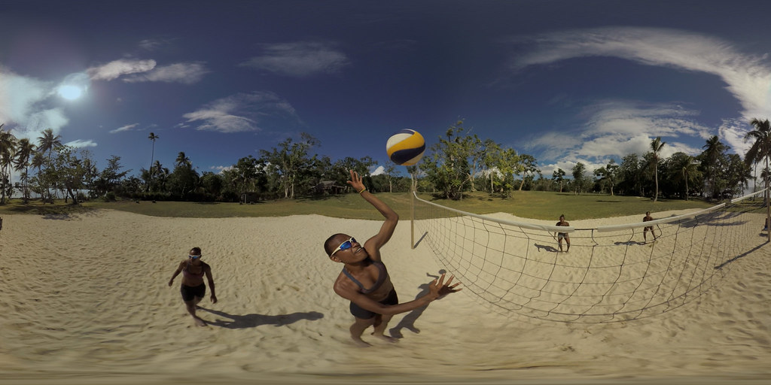
"Samsung Brings Fans Closer to Rio 2016 Olympic Games with Immersive “Vanuatu Dreams” Beach Volleyball VR Film" by Samsung Newsroom

Slide 20
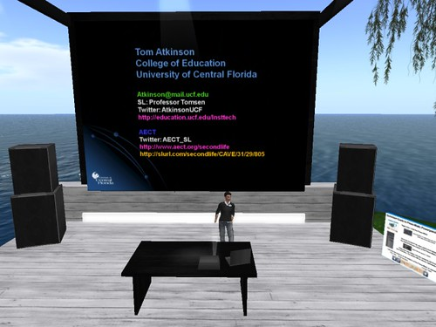
"Future is Now 2010-Prof Atkinson" by Robin M. Ashford

Slide 21
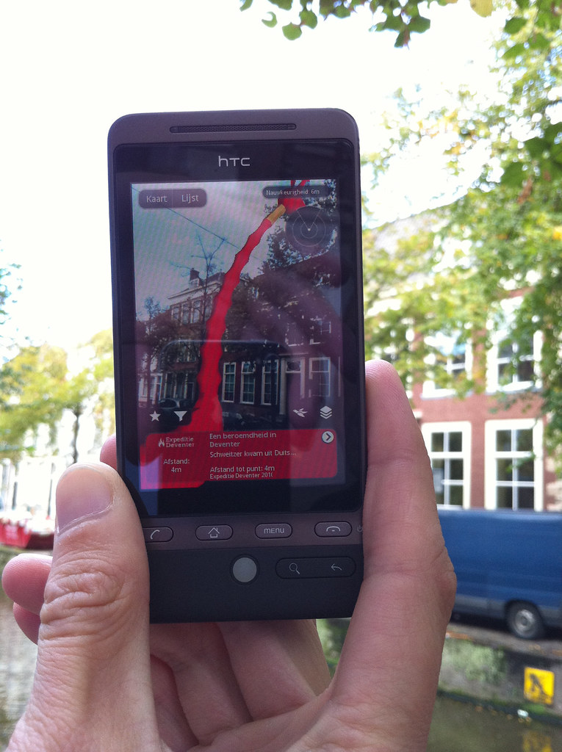
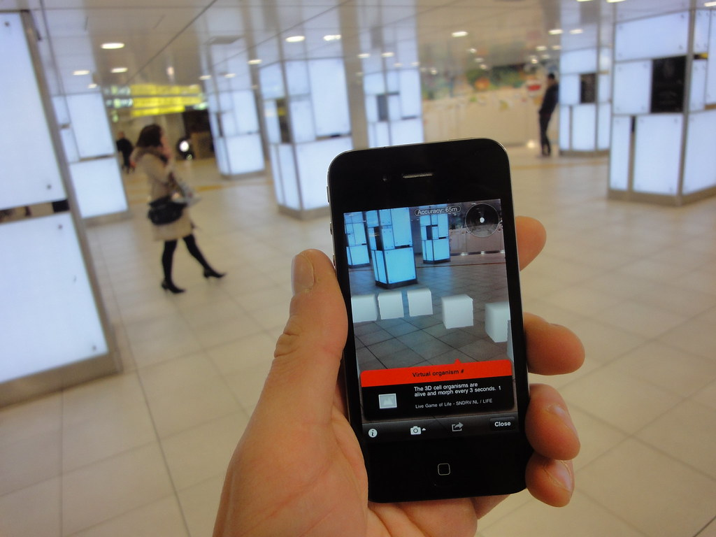
"augmented reality game bibliotheek deventer" by nilsmengedoht

Slide 22
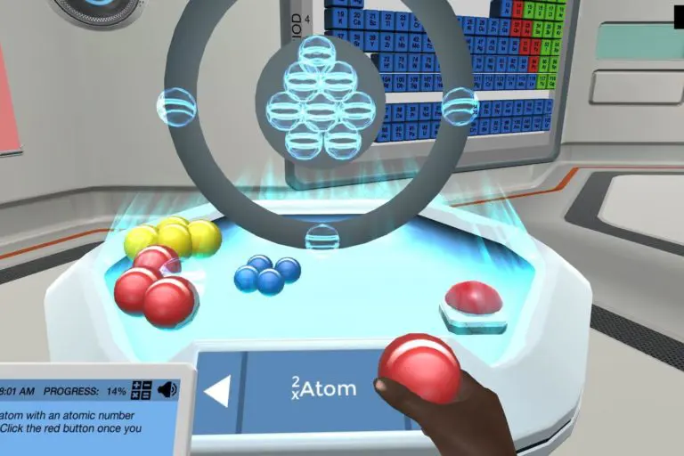
Labster. (n.d.) Virtual Labs. [Image] https://www.labster.com

Slide 23
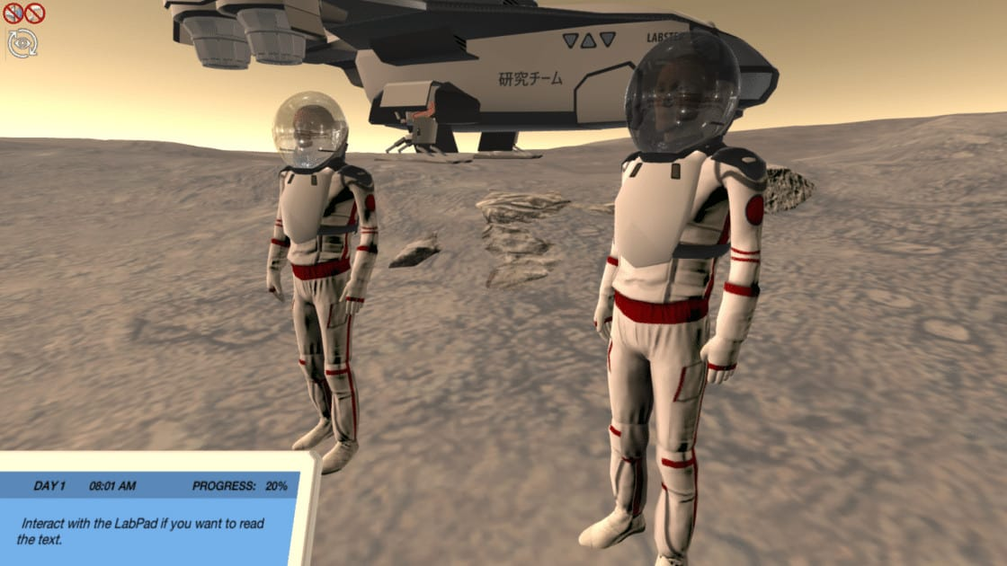
Labster. (n.d.) Virtual Labs. [Image] https://www.labster.com

